Slide 1
SureCan Incorporated

Slide 2
The Problem With Fuel Cans
According to the EPA each year
17,000,000 gallons of gasoline
are spilled while using gas cans.

Slide 3
Why are they spilling?
Simply, they are hard to use!
Make the user bend over, tip the can and pour from the top
No flow control.
Easy to overfill the machines fuel tank
When finished fueling, fuel cans must seal off airtight. Manufacturers are implementing hard to use spouts that have a hook and twist or push function. 90% of fuel cans use this type of spout.
Spouts are not long enough or flexible to properly reach the fill locations
Spouts break off if hit or dropped.
Impossible to use on small weed trimmers, leaf blowers, and automobiles .

Slide 4
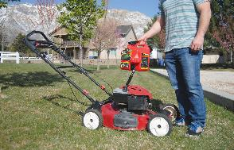
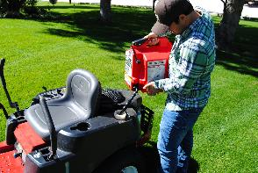
SureCan is the Solution
SureCan is designed with a patented 9” flexible rotating spout and thumb button that solves the problems caused from other fuel cans. SureCan allows the user to control the flow of fuel by depressing the thumb button release while at the same time being able to see into their machines fuel tank preventing over filling and spills. No more bending over, tipping and pouring.
See Video Below for Demonstration

Slide 5
Why SureCan?
SureCan vs. Competition
SureCan is not your same old “JUST” a gas can! SureCan is a revolutionary fuel can that
Is changing the industry and how consumers Feed Their Machines!
SureCan has a spout at the bottom and thumb button on top that allows the user to control
the flow.
All other fuel cans you have to tip or pour the fuel into the tank
Some have a button to push but you still have to use two hands and the spout is very short.
2. SureCan has a flexible rotating spout that allows the user to place into any tank at any angle!
No other newer fuel can has a flexible spout that comes with their can! Some offer an additional
Spout that you have to purchase extra.
3. SureCan has 6 individual layers in our tank wall that makes it the most durable plastic fuel can on
the market today!
Barrier layer in the middle prevents vapors/fumes from escaping
Eliminates spills, stress and smells with the SureCan.
Made with automotive standards.
Made with the best materials available. Viton Seals, stainless steel rivets and springs
4. SureCan has the vent underneath the thumb button that automatically vents once it is depressed.
All other fuel cans have the vent in the spout area which causes glugging or an uncontrolled flow.
5. MADE IN THE USA!

Slide 6
AWARDS / ACCOLADES
Most Innovative New Product Award 2014
2x Retailers Choice Award Winner!
2016 Edison Award Winner
Lawn & Garden Retailer Best of Show
3 Utah Best of State Awards
Inventor
Off Road Recreation Product
Business Innovation

Slide 7
AWARDS / ACCOLADES
2015 Annual Blow Molding Conference
1st Place
CONSUMER GOODS CATEGORY
INDUSTRIAL APPLICATIONS
3rd Place
INDUSTRIAL DIVISION AWARD
INDUSTRIAL CATEGORY AWARDS
PEOPLES CHOICE AWARDS
as voted by attendees of ABC 2015

