Slide 1
Enhanced Stage II Vapor Recovery and Storage Tank Evaporative Emissions
Ted Tiberi
ARID Technologies, Inc.
www.ARIDtech.com
630.681.8500
ttiberi@ARIDtech.com

Slide 2
Outline
Review of Storage Tank Evaporative Loss Dynamics
Section 4.1 of CP-201
Emission Factor <= 0.38 lb/1,000 gal
Fugitive Emissions <= 50% of this value, or 0.19 lb/1,000 gal
Section 4.6 of CP-201
Daily Avg <= 0.25 iwc
Daily High <= 1.50 iwc
TP-201.2 F, Section 9, Table 9.1
Use this format to tabulate fugitive emission factor
Combine the fugitive emission factor with site throughput to calculate mass emissions

Slide 3
Outline (cont’d.)
Based on capital and operating expense of control options, tabulate a cost effectiveness in $/lb or $/ton of VOC emissions reduced
With use of a benzene concentration level, based on a relevant observed hydrocarbon concentration of emitted vapors, tabulate a benzene emission factor
With guidance from “Scoping Plan”, consider designated levels for attaining and maintaining ambient air quality standards and acceptable risk levels for toxic exposure
Apply emission thresholds and cost effectiveness to range of GDF; for example GDF 1, 2, 3, 4, 5; with average throughput of 25 k gal, 37.5, 75, 150, and 300 k gal/month

Slide 4
The Uncontrolled System
ARID TECHNOLOGIES, INC. 2020

Slide 5
Uncontrolled System

Slide 6
Uncontrolled System

Slide 7
Uncontrolled System

Slide 8
Uncontrolled System

Slide 9
Uncontrolled System
0
-
+

Slide 10
Uncontrolled System
0
-
+

Slide 11
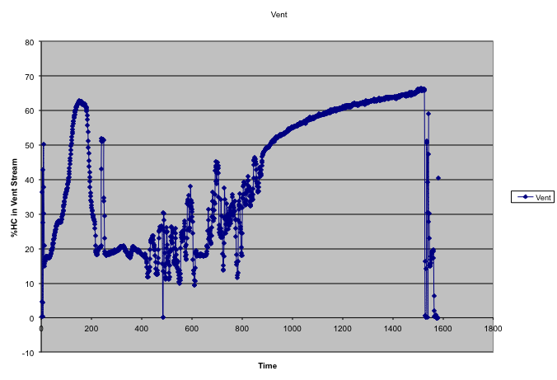
% HC, P/V ON

Slide 12
Stage II Recovery Systems

Slide 13
Stage II Recovery Systems
Balanced System
Vacuum-Assisted System

Slide 14
Stage II Recovery Systems
Balanced System
Vacuum-Assisted System

Slide 15
Vacuum-Assisted Recovery Systems
0
-
+

Slide 16
Vacuum-Assisted Recovery Systems
0
-
+

Slide 17
Vacuum-Assisted Recovery Systems
0
-
+

Slide 18
Vacuum-Assisted Recovery Systems
0
-
+

Slide 19
Vacuum-Assisted Recovery Systems
0
-
+

Slide 20
ORVR Configuration
Enhanced Evap/ORVR Canister
Vapor Line
Pressure Relief Valve
Shut-off Valve
Check Valve

Slide 21
ORVR Systems

Slide 22
ORVR Systems

Slide 23
ORVR Systems

Slide 24
ORVR Systems
0
-
+

Slide 25
ORVR Systems
0
-
+

Slide 26
Permeator™ Systems

Slide 27
Permeator™ Systems

Slide 28
Permeator™ Systems
0
-
+

Slide 29
Permeator™ Systems
0
-
+

Slide 30
Permeator™ Systems
0
-
+

Slide 31
Permeator™ Systems
0
-
+

Slide 32
Permeator™ Systems
0
-
+

Slide 33
Permeator™ Systems
0
0
-
-
+
+

Slide 34
Groundwater Contamination
0
-
+

Slide 35
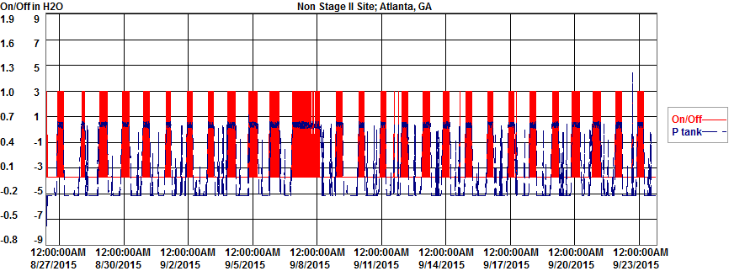
Non Stage II Site w/Permeator
Atlanta, GA

Slide 36
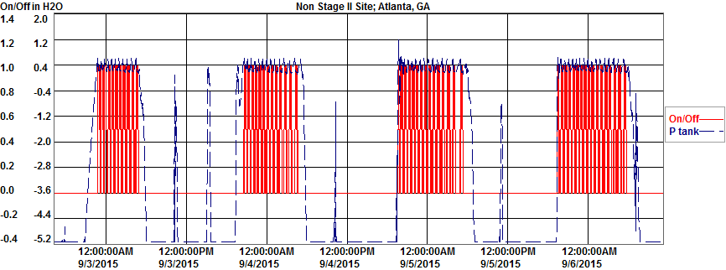
Non Stage II Site w/Permeator
Atlanta, GA

Slide 37
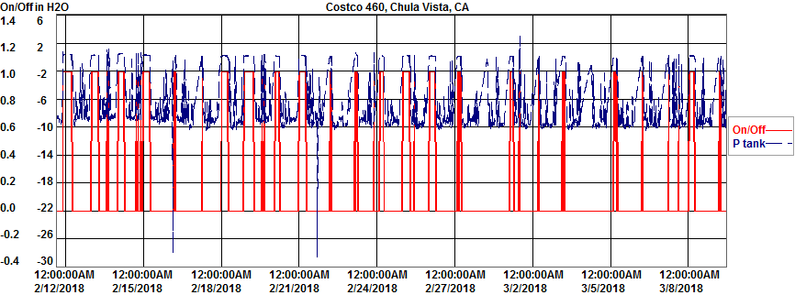
460 Chula Vista

Slide 38
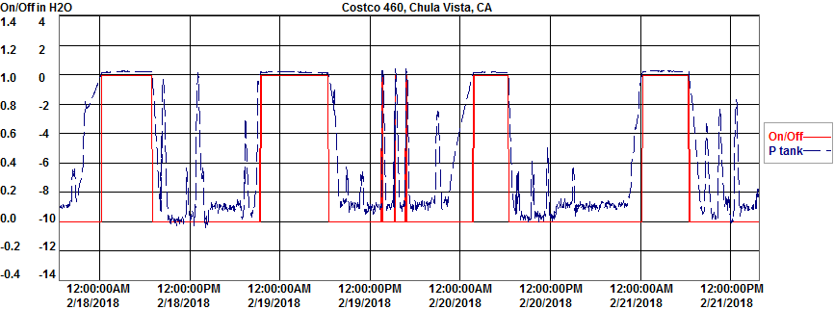
460 Chula Vista

Slide 39
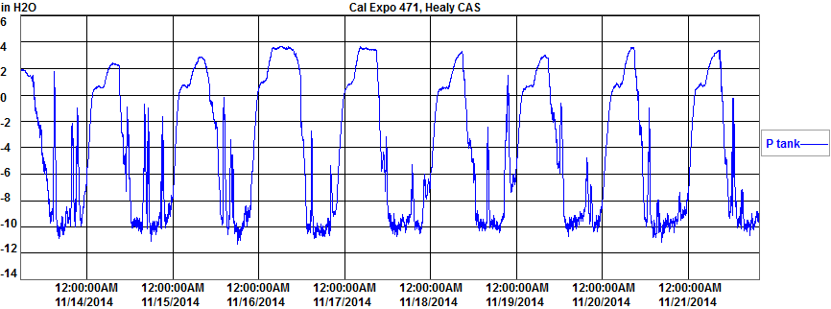
HEALY CAS, No PERMEATOR

Slide 40
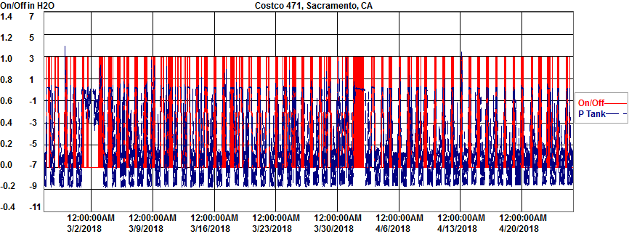
471 Cal Expo

Slide 41
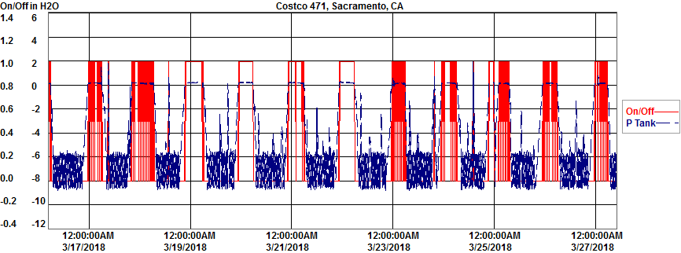
471 Cal Expo

Slide 43
Table 9.1 |  |  |  |  | Equ 9.2.1 |  | Equ 9.2.2 |  | Equ 9.3.1 |  |  |  | Equ 9.4.1
cfm | P range value |  | minutes |  | V (ft3) |  | Q (CFH) |  | M | C | MW | MV | E (lbm/1,000 gal)
0.005254688 | 0.125 |  | 825.97 |  | 4.340190414 |  |  |  | lbm/hr
0.05024674 | 1.13 |  | 1423.94 |  | 71.54836636
0.07666982 | 2.13 |  | 827.97 |  | 63.47995689
0.0203118 | 0.38 |  | 2393.90 |  | 48.62441624
0.05770824 | 1.38 |  | 1275.95 |  | 73.6326357
0.08236432 | 2.38 |  | 1081.95 |  | 89.11446841
0.03248555 | 0.63 |  | 2395.90 |  | 77.83212368 | ft3
0.06449474 | 1.63 |  | 753.97 |  | 48.62700089
0.09049328 | 2.76 |  | 1069.96 |  | 96.82376145
0.0420968 | 0.88 |  | 1689.93 |  | 71.14061765
0.07060624 | 1.88 |  | 825.97 |  | 58.31831598
0.10671182 | 3.63 |  | 2597.89 |  | 277.2257177
 |  |  |  | V total | 980.7075713 |  | 1.230087262 |  | 0.050478192 | 36 | 44 | 386 | 0.242683617
 |  |  |  |  | 980.7075713 |  | 1.230087262 |  | 0.064499912 | 46 | 44 | 386 | 0.310095733

Slide 44
Healy CAS Fugitive Emissions
E = 0.31 lb/1,000 gal
Daily Avg <= 0.25 iwc; 85% Failure Rate
Daily High <= 1.50 iwc; 78 % Failure Rate
75th percentile of 30 day pressue = +0.75 iwc
Failed 0.3 iwc limit
Are Fugitives > 50% of Overall Emission Factor?
.50 x 0.38 = 0.19 lb/1,000 gal
YES; system does not meet CARB Specifications for Certification

Slide 46
Table 9.1 | P range value |  |  |  | Equ 9.2.1 |  | Equ 9.2.2 |  | Equ 9.3.1 |  |  |  | Equ 9.4.1
cfm |  |  | minutes |  | V (ft3) |  | Q (CFH) |  | M | C | MW | MV | E (lbm/1,000 gal)
0.005254688 | 0.125 |  | 12737.47 |  | 66.93140913 |  |  |  | lbm/hr
0.05024674 | 1.13 |  | 0.00 |  | 0
0.07666982 | 2.13 |  | 0.00 |  | 0
0.0203118 | 0.38 |  | 4935.79 |  | 100.2548504
0.05770824 | 1.38 |  | 2.00 |  | 0.115411651
0.08236432 | 2.38 |  | 2.00 |  | 0.164721748
0.03248555 | 0.63 |  | 36.00 |  | 1.169430874
0.06449474 | 1.63 |  | 0.00 |  | 0
0.09049328 | 2.76 |  | 2.00 |  | 0.180978988
0.0420968 | 0.88 |  | 0.10 |  | 0.004209504
0.07060624 | 1.88 |  | 0.00 |  | 0
0.10671182 | 3.63 |  | 0.00 |  | 0
 |  |  |  | V total | 168.8210123 | ft3 | 0.211891489 |  | 0.008695236 | 36 | 44 | 386 | 0.04180402
 |  |  |  |  |  |  | 0.211891489 |  | 0.01111058 | 46 | 44 | 386 | 0.053416248

Slide 47
ARID Permeator Fugitive Emissions
E = 0.053 lb/1,000 gal
Daily Avg <= 0.25 iwc; 0% Failure Rate
Daily High <= 1.50 iwc; 0 % Failure Rate
75th percentile of 30 day pressue = +0.18 iwc
Passed 0.3 iwc limit
Are Fugitives > 50% of Overall Emission Factor?
.50 x 0.38 = 0.19 lb/1,000 gal
NO; system meets CARB Specifications for Certification

Slide 49
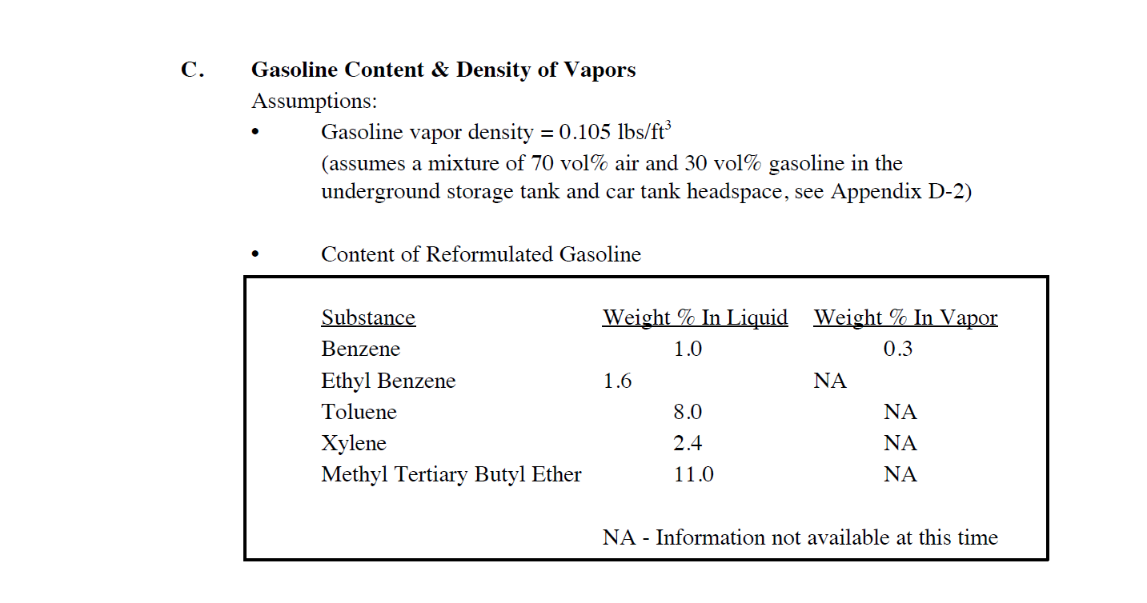
Are benzene weight % values accurate considering
Elevated vapor concentration of hydrocarbon emissions?

Slide 50
Fugitive Emission Factor as Basis for Mass Emission Rate at Specific GDF
Fugitive Emission Factor (lb/1,000 gal), E
E x GDF Throughput/month = lb/month
Threshold and Cost Effectiveness Determined by ARB
Monthly VOC Emission Limit
Monthly Benzene Emission Limit
Costs per Ton of VOC reduced
ARB can develop requirements to GDF based on throughput range
For example GDF1, GDF2, GDF3, GDF4, GDF5 for throughputs of 25 k gal, 37.5 , 75, 150, and 300 k gal

Slide 51
IT Backbone/Infrastructure
Internet enabled ISD systems provided by Veeder-Root and Franklin Fueling Systems are presently in widespread use throughout CA
ISD raw data acquisition in place as percentile metrics are presently calculated daily
The percentile calculations can be augmented or replaced by the pressure interval calculations
The Pressure Interval metrics are subsequently used to calculate fugitive emission factors
The fugitive emission factors are then used to tabulate absolute, site specific emissions levels which are the product of (Emission Factor) x Throughput

Slide 52
Modification of ISD to include fugitive and vent emission rates
Seems like an incremental investment to include simple programming within the ISD systems provided by Veeder-Root and Franklin Fueling Systems
Pressure data is important, but at present, these metrics are “stand-alone”
Key is to use existing pressure data to calculate emission rates, both fugitive and vent
The emission rates are then combined with site throughput to yield meaningful and useful metrics for ARB to use in their focused rulemaking

