Slide 1
MINE METHANE CAPTURE AND CALIFORNIA CAP AND TRADE.
Vessels Coal Gas, Inc.
2016 Global Methane Institute
Washington DC March, 2016
Vessels Coal Gas Inc™
1

Slide 2
A nightmarish process, any little help that a government entity can do for us will be overwhelmingly welcome.
Vessels Coal Gas Inc™
2

Slide 3
Rounding and Estimates Any calculations used and quantities referred to in this presentation are intentionally rounded to provide estimates. Using actual numbers in specific cases will provide different values then those used in this presentation. Factors of conversion of methane to metric tons of Carbon Dioxide equivalent (tCO2e) and to equivalent emissions from other sources of greenhouse gas were taken from the IPCC and US EPA’s web sites.
Vessels Coal Gas Inc™
3

Slide 4
Risk
Deep seated opposition to Offsets.
Amongst parties concerned with the escalation of climate change there are individuals and organizations who are strongly opposed to offsets.
We do not sense urgency amongst many involved with mitigating climate change.
Suspicion of financial incentives and markets as tools to slow global warming hamper quick progress.
“If people pollute they should clean it up.”
Vessels Coal Gas Inc™
4

Slide 5
Financial Investors and public policy makers have questions.
Why Coal Mine Methane?
Increasing number of frost free days per year in Colorado. Page 11 of Climate Change & Aspen, An Update on Impacts to Guide Resiliency Panning & Stakeholder Engagement, Aspen Global Change Institute, 2014, James Arnott, Elise Osenga, John Katzenberger. GI_canary_ClimateChangeAspen2014ExecSum
Methane and Soot most urgent to reduce. Page 183 of SCIENCE, January 13, 2012, Vol. 335, Simultaneously Mitigating Near-Term Climate Change and Improving Human Health, and Food Security, Drew Shindell etal.
Vessels Coal Gas Inc™
5

Slide 6
MARKETING FIRST
WHY METHANE?
Global warming potential (GWP) for non CO₂ Greenhouse Gases (GHG) to reflect the Intergovernmental Panel on Climate Change (IPCC) Fourth Assessment Report (AR4) timescale over twenty years has the potential to incentivize a great deal of activity in reducing highly potent GHGs.
Using a GWP of 100 years when the next 20 years are the most important does not compel a change of behavior as fast as is necessary.
Vessels Coal Gas Inc™
6

Slide 7
2012: Hottest Year Ever for Lower 48
Science Magazine recently published a study showing that methane and soot reduction would have the most significant, immediate, and cost effective impact slowing on global warming.
GLOBAL WARMING POTENTIAL
Vessels Coal Gas Inc™
7

Slide 8
Climate Protection: Waste Methane reduces > 10 tCO2e/1,000 kilo watt hours
Vessels Coal Gas Inc™
8

Slide 9
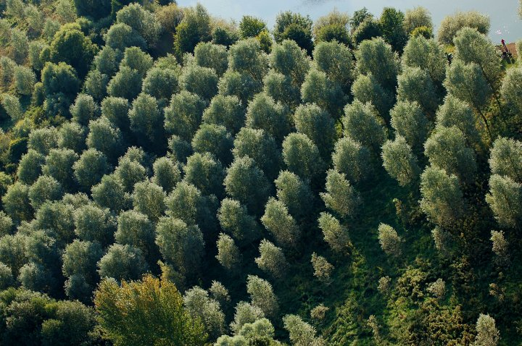
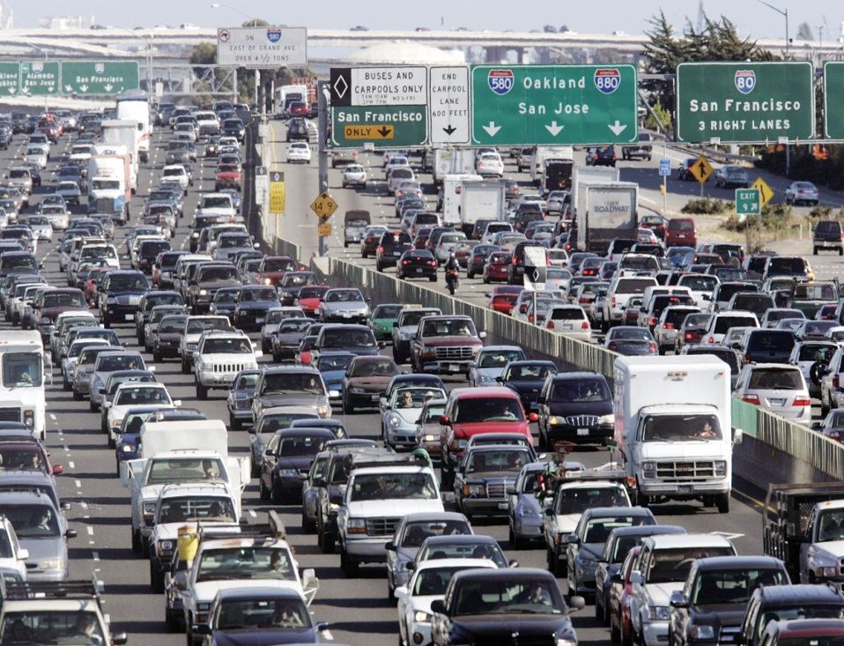
Waste Methane generating 1,000 kilo watts per hour annually avoids climate damage of more than 80,000 Tonnes of CO2e each year.
PLANTING ≈ 200,000 TREES
REMOVING ≈
16,000 CARS
Vessels Coal Gas Inc™
9
Notes:
Buying wind power is the single most important environmental decision you can make. Spending $30 per year on wind is equivalent to planting one-half acre of trees according to the EPA.

Slide 10
Estimated conversion assumptions.
9,000 cubic feet of methane ≈ 1,000 kwhrs.
1,000 kwhr = 1 MWHR.
1MWHR x 24 hours x 365 days x 90% operating time ≈ 8,000 MWHRs
72 GWP / California GWP of 21 = 3.43
1,000 scf of CH4 = 0.348 tCO2e at a GWP of 21
0.348 x 3.43 = 1.19 tCO2e
9mcf of CH4 x 1.19 = 10.71 tCO2e at 20 years.
8,000 MWHRs per year avoids climate damage of > 80,000 tCO2e.
Vessels Coal Gas Inc™
100

Slide 11
COMPLIANCE CARBON MARKET MAKES IT HAPPEN
Voluntary Markets insufficient to pay the cost carbon reduction.
Compliance Markets Work
Buyers come looking for us.
Destruction of methane for carbon offsets avoids electricity generation competition.
Electricity market is zero sum game and needs competitive lobbying to grow.
Natural gas is dead.
Vessels Coal Gas Inc™
111

Slide 12
END USER OF OFFSETS MOST MOTIVATED
Large Corporations do not want to control your life.
They just want the offsets.
Their interest is stronger the more established and settled the compliance market becomes.
Relationship is as sound as any commercial producer to end user.
Reasons to renegotiate and foster relationship.
They understand the business.
Vessels Coal Gas Inc™
122

Slide 13
Investors Do Not Understand Industry.
"Tax credits, right?”
People are paying you so they can keep polluting?!
You are subsidizing dirty industry.
California is paying you to reduce pollution not even in their state!
Have you done this before?
What if the Federal government does something?
But what is it you do?
Why can’t we go with you to make offer to coal company?
We want to sell electricity not burn methane.
How do you know someone is going to pay you for burning methane?
So who are we going to sell the Coal Bed Methane to?
We need to have control.
We need a different deal then the one you have already negotiated.
But you are releasing CO2 when you burn methane?
Vessels Coal Gas Inc™
133

Slide 14
All Equity Investors Are Alike.
Risk Averse
Preservation of principal more important than risking capital for profit.
No prior analogies in the USA.
No experience with small scale electricity generation markets and less with carbon markets.
Equity financing with downside protection primary option.
Limited Liability Companies are the flavor du jour.
Debt unavailable until after 2 years operating history.
Need proof of concept.
Contract oriented vs relationship oriented.
Vessels Coal Gas Inc™
144

Slide 15
Carbon Project Financing – Most Practical Financing Model.
Minimize spending time and expense on negotiating transaction or raising capital.
Start a project as soon as you can.
Negotiate terms that work well enough to get started.
Gain experience and become a player.
Each project can have separate ownership, financing, and management.
In the USA Limited Liability Companies are the most efficient form for project financing.
Vessels Coal Gas Inc™
155

Slide 16
How to Approach Project Investors.
Develop project as much as you can before you talk to investors.
Negotiate with yourself first (know what you want)
Investor will be dominant until investment is returned.
Seek out financial parties already interested.
Financing from an end user of the carbon offsets.
Financing from an end user of electricity.
Vessels Coal Gas Inc™
16

Slide 17
Options for MMC Project Developers to Manage the Economic and Legal Risks from Mine Closure?
Negotiated contract should include rights to mine methane before and after mine closure.
Stay very close to mine management and owners.
Take over assets that will be needed to operate.
Owner of methane needs some financial benefit.
Vessels Coal Gas Inc™
177

Slide 18
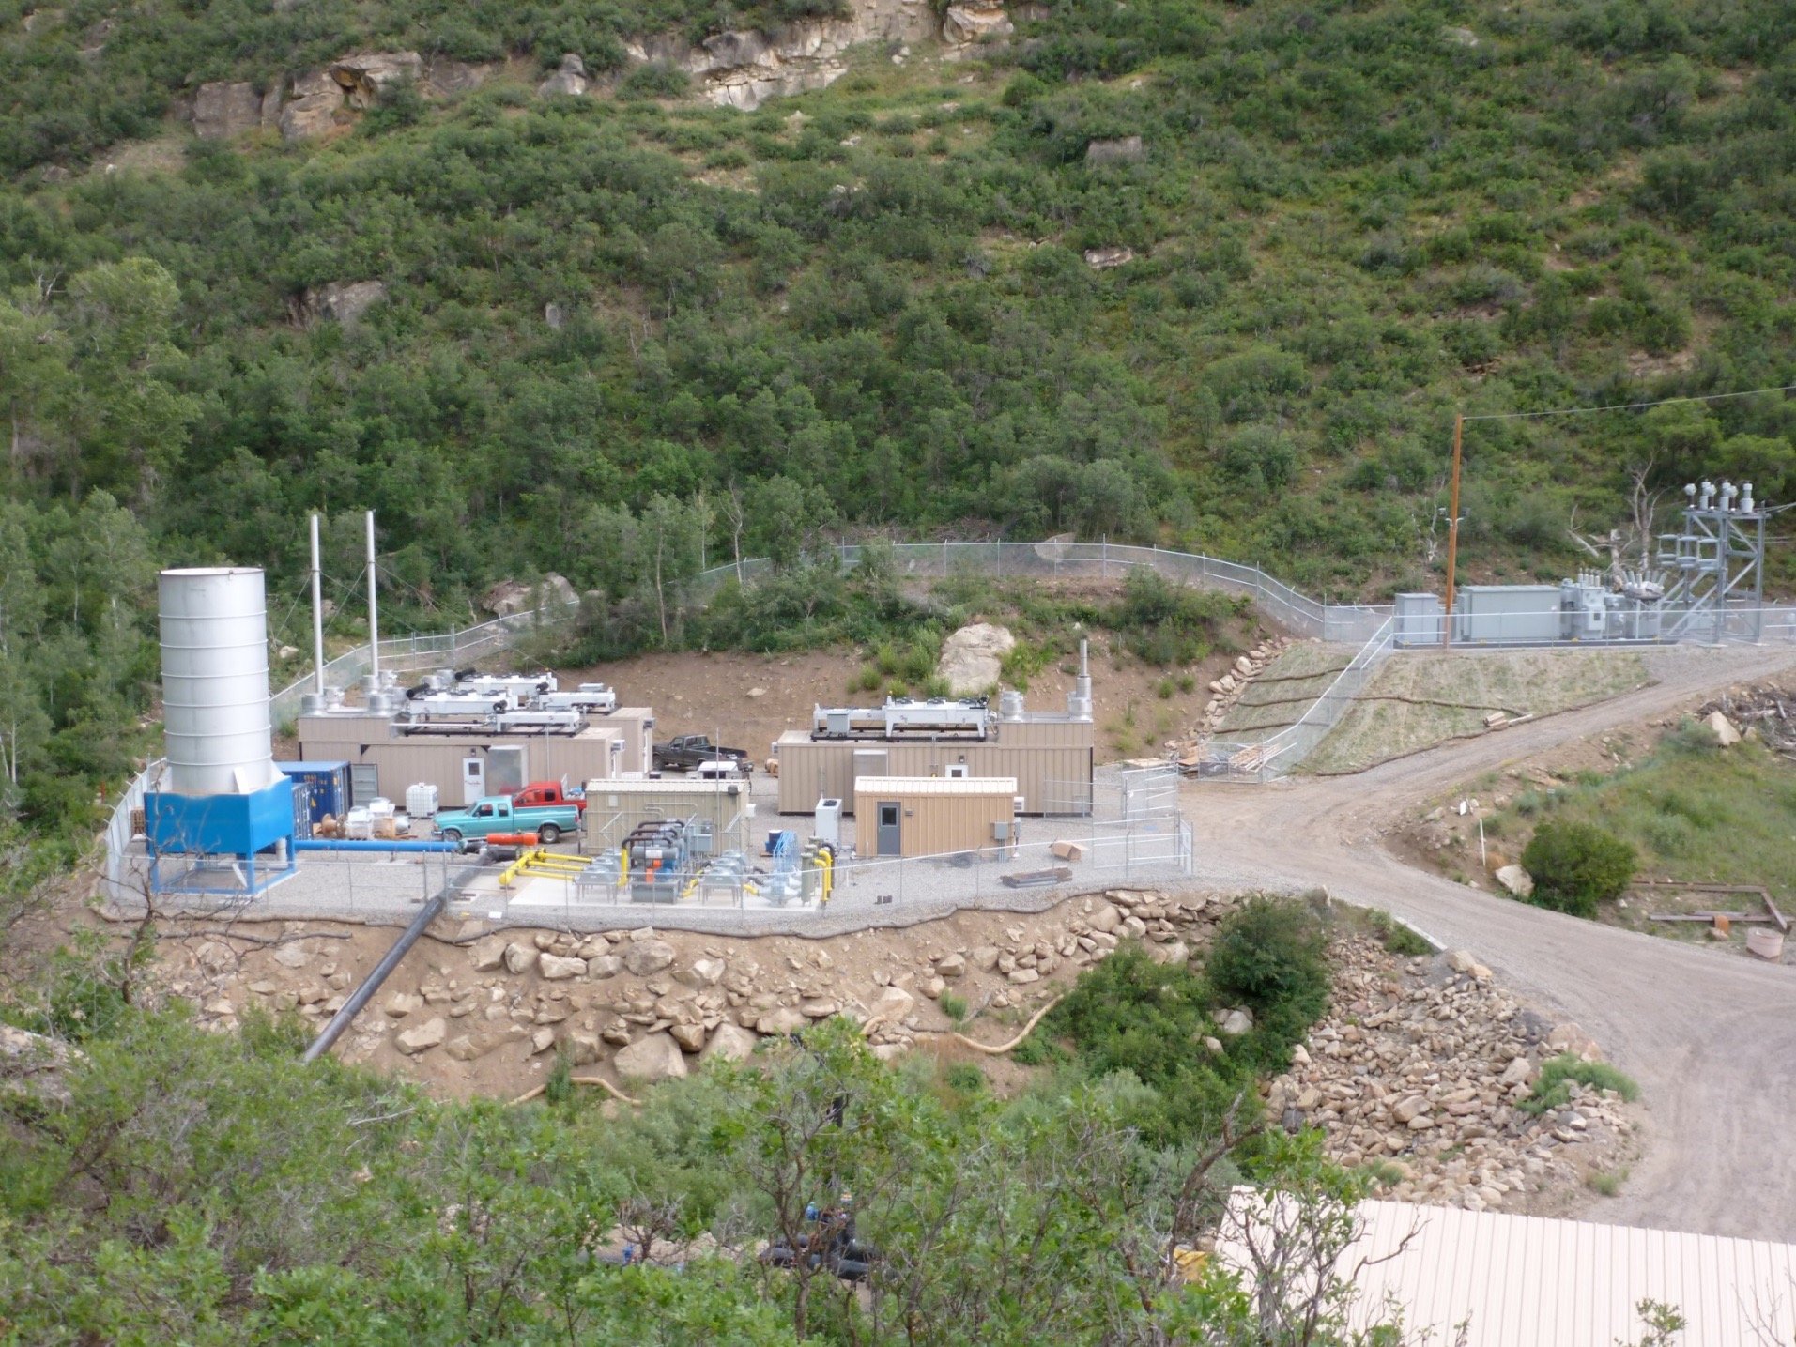
Elk Creek Coal Mine Methane
Destruction and Utilization Project
Elk Creek Coal Mine Methane Destruction and Utilization Project
3 MW (3,000 kilowatts) of electricity generation capacity combusting 600 scfm of methane.
Enclosed combustion of up to 2,500 scfm of excess waste methane.
Reliability: 95% operational availability 2014 & 2015.
Design flexibility: 20 – 90% methane gas concentration.
Thermal Oxidizer
Three 1MW Containerized Generators
9 MW Substation
Control buildings
Pipeline
Gas conditioning:
Remove water, Filter,
Cool, Pressurize.
Vessels Coal Gas Inc™
188

Slide 19
CALIFORNIA MINE METHANE CAPTURE PROTOCOL WILL NOT IMPROVE WITHOUT ADVOCACY.
Global Warming Potential 21 not 72.
2,600 scf of methane emission reduction = 1 ARBOC not 800 scf.
Current GWP of 100 years not next 20.
0.35 tCO2e per 1,000 scf of CH4 not 1.19 tCO2e
$3.50 per tCO2e not $14.30
Invalidation risk distraction and risk.
Vessels Coal Gas Inc™
199

Slide 20
Vessels Coal Gas Inc.
Mine methane capture and California cap and trade.
2016 Global Methane Institute
Washington DC March, 2016
Vessels Coal Gas Inc™
20

